Slide 1


Air Quality Guardian
Smart Environmental Monitoring System

Slide 2

Problem Statement
Air pollution and poor indoor air quality can cause health problems such as breathing difficulties, allergies, and fatigue. However, many people are unaware of the pollution levels around them because they lack monitoring systems.
Therefore, there is a need for a simple, affordable system that can continuously monitor air quality and environmental conditions and alert users when levels become unsafe.

Slide 3
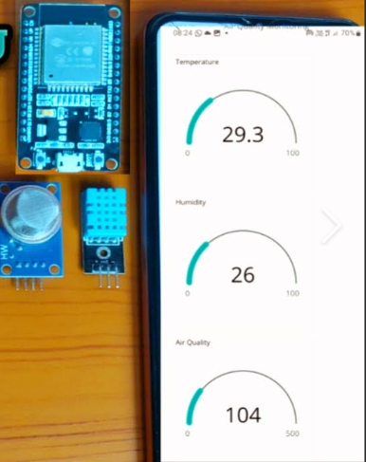
Objectives
1)Monitor air quality using sensors 2)Measure temperature and humidity 3)Display real-time data on LCD 4)Provide alerts when pollution level increases 5)Improve environmental awareness

Slide 4
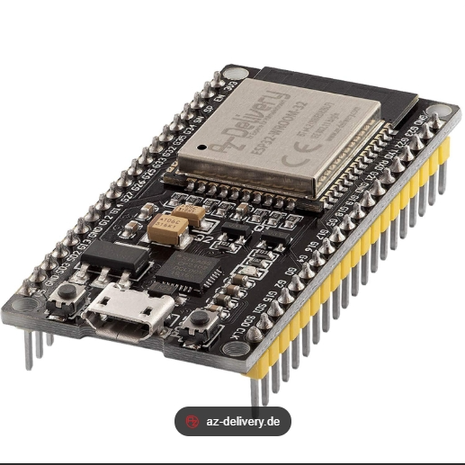
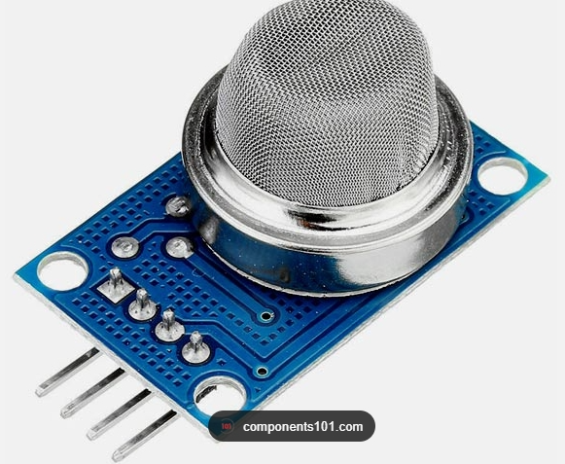
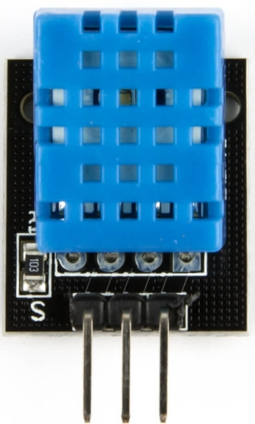
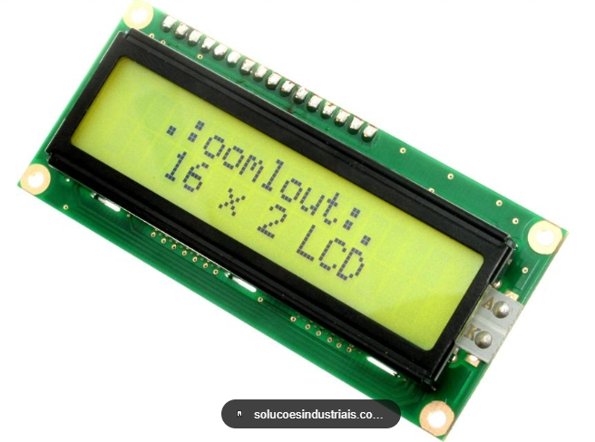
Hardware
ESP32
MQ Gas Sensor (Air Quality Detection)
DHT Sensor (Temperature & Humidity)
16x2 LCD Display
Breadboard
Jumper Wires
USB Power Supply
Software
Arduino IDE
Embedded C programming
Sensor libraries

Slide 5
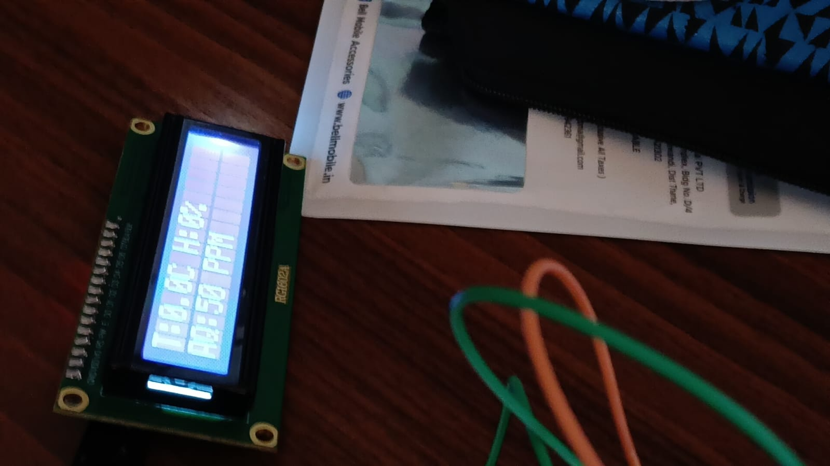
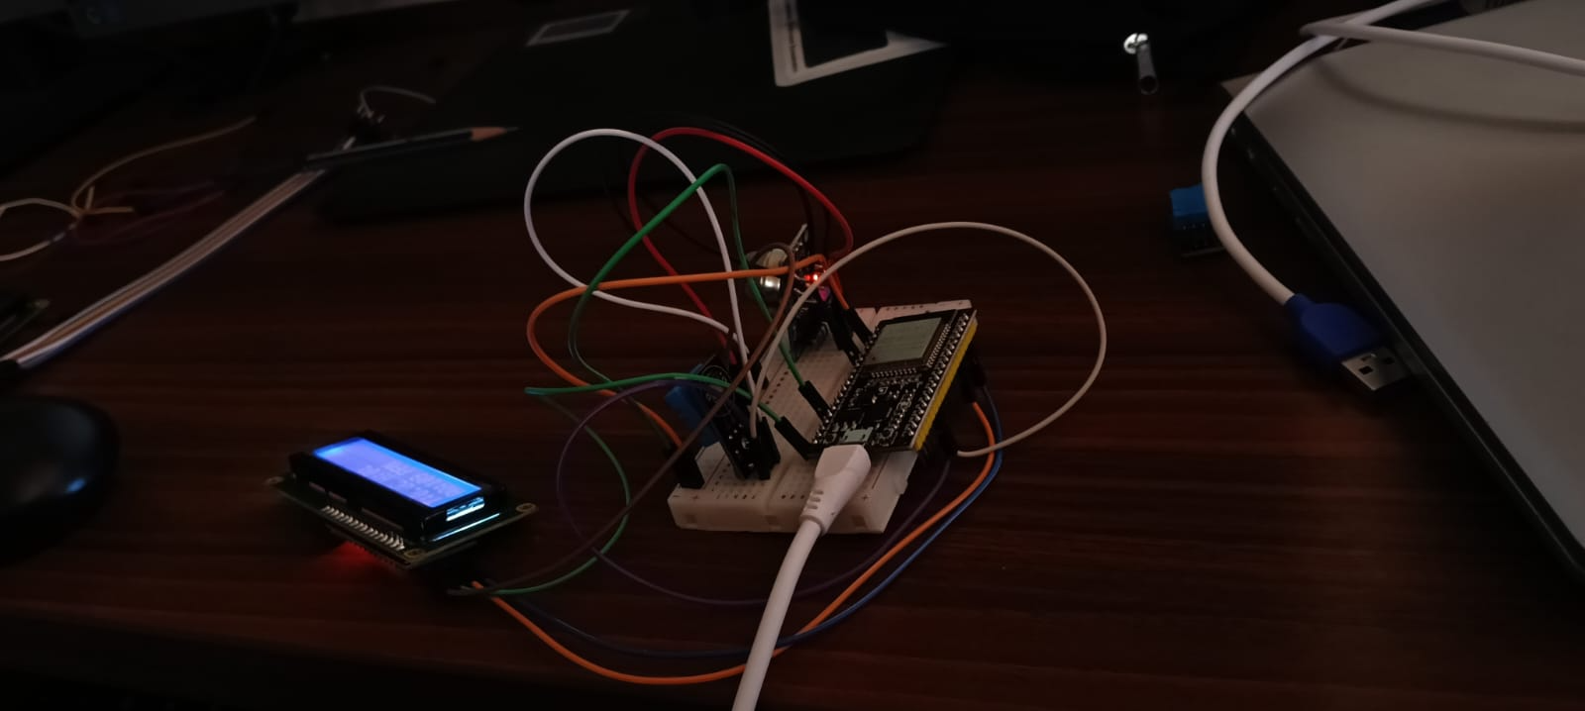
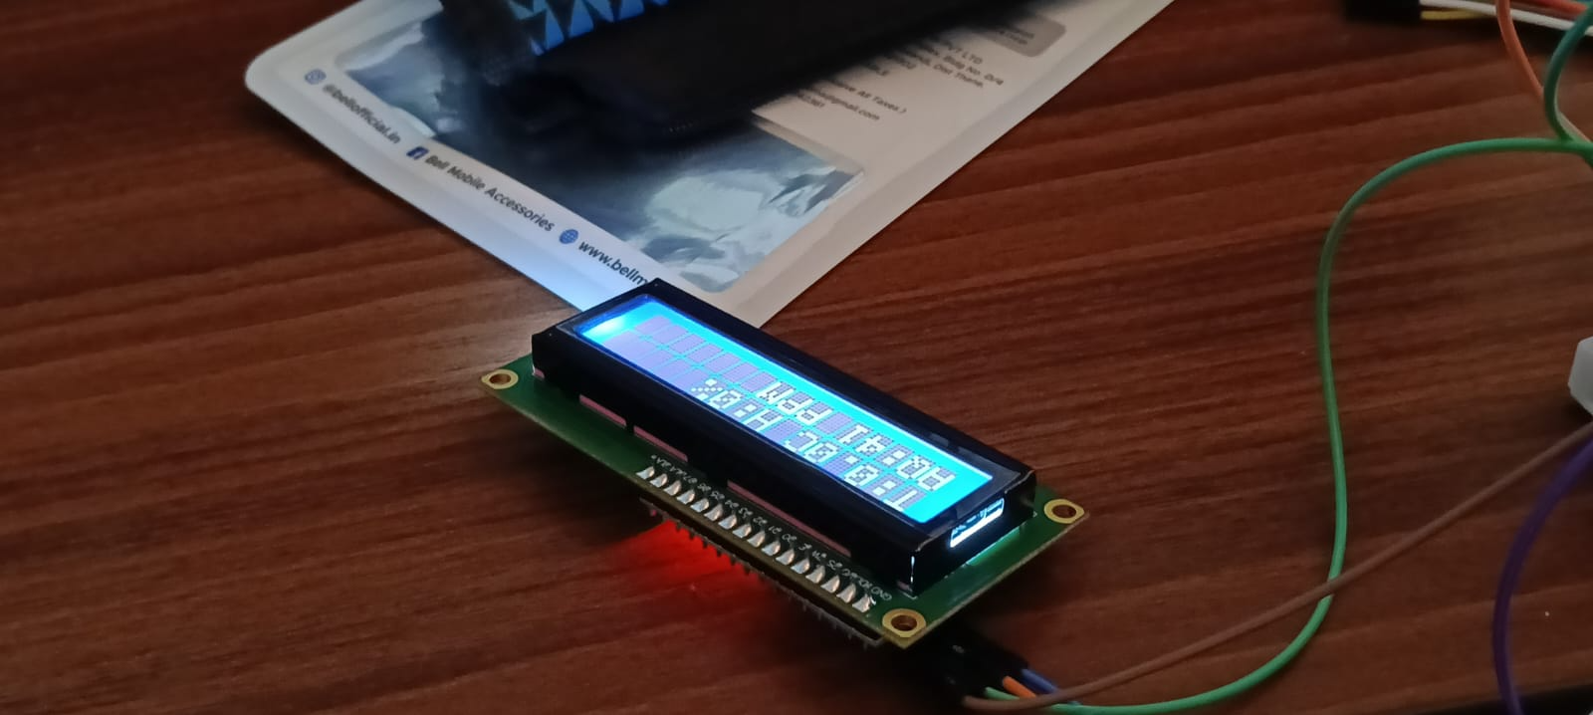
WORKING PRINCIPLE

Slide 6
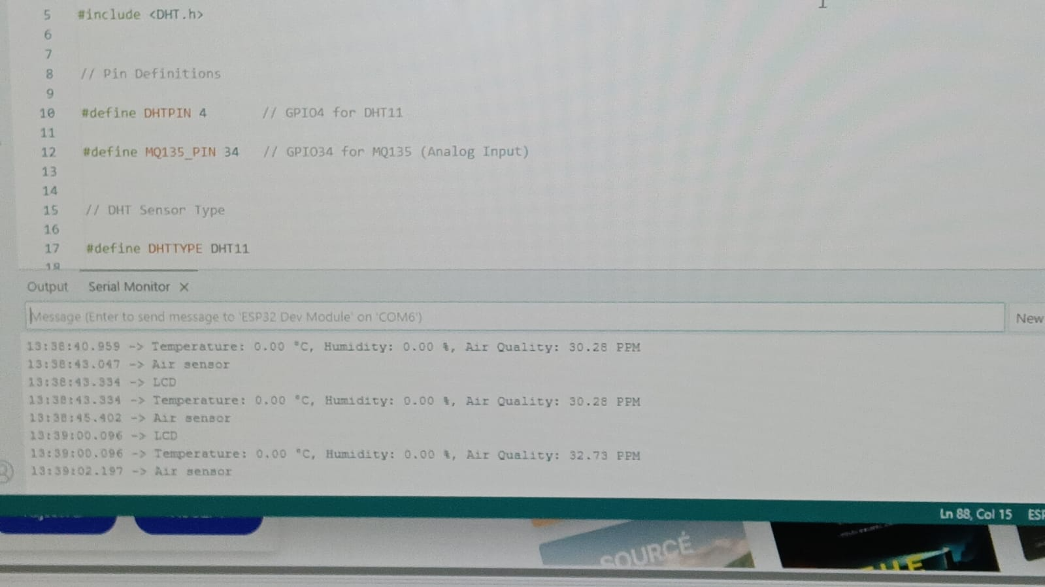
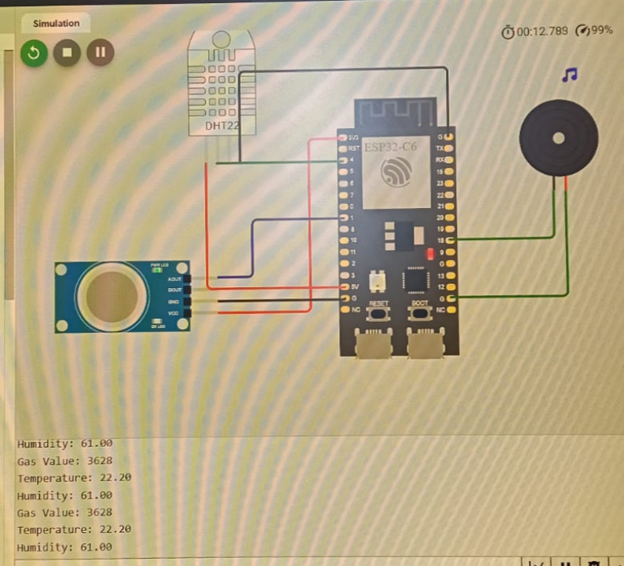
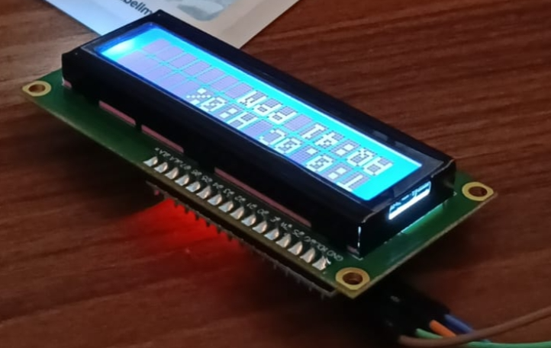
Results / Output

Slide 7

Challenges Faced
Sensor calibration issues
Difficulty uploading code to ESP32
Library compatibility problems
Wiring errors in the breadboard setup
Sensor value fluctuations

Slide 8
Thank you

